Slide 1
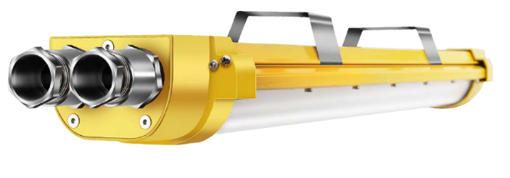
Explosion Proof Highbay
OZ-EXHB-01
Electrical data |  |  | Photometric Data
Model | OZ-EXLL-02 |  | Color Temperature - CCT | 3000K, 4000K, 6000K
Operating Frequency | 220-265 V, 50/60Hz |  | Color Rendering Index | >80
Power Factor λ | >0.95 |  | Sdcm | <6
Efficiency In % | >92% |  | Thermal Conductivity | 226 W/m K
Start time(0.2s/0.5s/... | 0.1S |  | THD | <15
Warm-up time to 60% | 0.5S |  | Life Span
Driver | Explosion Proof |  | Rated Nominal Life time | 50,000 hrs.
Corrosion Proof | WF2 |  | Switching cycle | 100,000 times
Source | Led Bridgelux |  | Led Device life time | L90/B10 @ 50,000H
Material & Protection |  |  | Luminous | 130Lm/w
Ingress Protection | IP65 |  | Temperature
Impact protection | IK10 |  | Operating temperature | -40~+50c
Surge Protection | 4KV |  | Optional | ZigBee, PWM, DALI, 0/1~10V
Installation | Multiple |  | Options | Built-in Emergency Kit
Material | Pure Aluminum A6063 |  | Warranty | 5 Years
IP65
PF
>0.95
CRI
>80
50000h
Item Ref | Power | Luminous flux | Source | Corrosion-proof | P.F | CRI | Size-mm
OZ-EXHB-02-620 | 20 watt | 2400Lm | Bridgelux | WF2 | > 0.95 | >70 | 735x115x63
OZ-EXHB-02-640 | 40 watt | 4800 Lm | Bridgelux | WF2 | > 0.95 | >70 | 735x115x63
OZ-EXHB-02-1240 | 40 watt | 4800 Lm | Bridgelux | WF2 | > 0.95 | >70 | 1335x115x63
OZ-EXHB-02-1260 | 60 watt | 7200 Lm | Bridgelux | WF2 | > 0.95 | >70 | 1335x115x63
OZ-EXHB-02-1280 | 80 watt | 9600 Lm | Bridgelux | WF2 | > 0.95 | >70 | 1335x115x63
FSI-UNi
1. Cree LED, whole fixture 130lm/w
2. Meanwell driver, 5 years warranty
3. With ATEX certificate
4. Symbol: II 2 G Ex de IIC T5 Gb
NO. | Model | LED | Watt (W) | Voltage (V) | Lumen (lm) | CRI | Power factor | IP | Corrosion-proof | Size (mm) | Price
1 | EX-60W | Cree | 60W | 85~305V | 7800 | >70 | >0.95 | IP66 | WF2 | 325*315 | $250.80
2 | EX-80W | Cree | 80W | 85~305V | 10400 | >70 | >0.95 | IP66 | WF2 | 325*315 | $264.00
3 | EX-100W | Cree | 100W | 85~305V | 13000 | >70 | >0.95 | IP66 | WF2 | 325*315 | $284.40
4 | EX-120W | Cree | 120W | 85~305V | 15600 | >70 | >0.95 | IP66 | WF2 | 325*315 | $290.40
5 | EX-150W | Cree | 150W | 85~305V | 19500 | >70 | >0.95 | IP66 | WF2 | 325*315 | $356.40

Slide 2
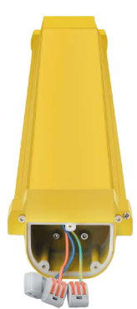
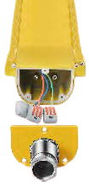
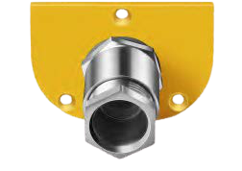
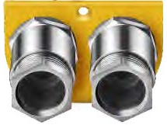
Explosion Proof Linear
OZ-EXLL-02
Wago
Easy Connectors
Easy Rewiring, Cost Saving
Linkable in Series
Each fixture has end cap with one gland and two glands for options. It can be open very easily. With 3x2.5mm, 2 wire through, it is linkable in series
Application
Flammable and explosive chemical materials Factory, Parking and Storage
Features Applied to oil fields, oil refineries, offshore oil platform, power plants, gas stations, oil tanks, wharf, tunnel, pumping station, substation, the military base etc. Zone I and Zone II Hazardous Locations, Zone 20, Zone 21, Zone 22 and II A, lIB, IIC explosive gas atmosphere.
Standard
The drawings, technical documents and the samples are verified and certified according to stands for safety as below:
EN60079-0-2010 explosive atmospheres Part 1: Equipment-General requirements
EN60079-0-2010 explosive atmospheres Part 3: Equipment protection by increased safety "e"
EN60079-18-2004 Electrical apparatus for explosive gas atmosphere 9: Encapsulation
FSI-UNi
1. Cree LED, whole fixture 130lm/w
2. Meanwell driver, 5 years warranty
3. With ATEX certificate
4. Symbol: II 2 G Ex de IIC T5 Gb
NO. | Model | LED | Watt (W) | Voltage (V) | Lumen (lm) | CRI | Power factor | IP | Corrosion-proof | Size (mm) | Price
1 | EX-60W | Cree | 60W | 85~305V | 7800 | >70 | >0.95 | IP66 | WF2 | 325*315 | $250.80
2 | EX-80W | Cree | 80W | 85~305V | 10400 | >70 | >0.95 | IP66 | WF2 | 325*315 | $264.00
3 | EX-100W | Cree | 100W | 85~305V | 13000 | >70 | >0.95 | IP66 | WF2 | 325*315 | $284.40
4 | EX-120W | Cree | 120W | 85~305V | 15600 | >70 | >0.95 | IP66 | WF2 | 325*315 | $290.40
5 | EX-150W | Cree | 150W | 85~305V | 19500 | >70 | >0.95 | IP66 | WF2 | 325*315 | $356.40

